Slide 1
Predicting Future NBA Success
For General Managers and Head Coaches
By Satvik Reddy

Slide 2
Project Overview
The best NBA players reach the distinction of making an All-Star, All-NBA, or All-Defense team during their careers
Once these honors are achieved, player values drastically increase, and the competition to gain those players’ services increases for general managers
By predicting which players have the potential to achieve an honor after only their rookie season, head coaches will be able to focus development efforts better, and general managers will be able to focus their resources on the correct players.

Slide 3
Data Information
NBA player statistics for every season dating back to 1950 was made available on Kaggle by Omri Goldstein.
Dataset contains basic statistics like points, rebounds, and assists, and advanced statistics like WS (win shares) and VORP (Value over replacement player).
All-Star, All-NBA, and All-Defense data was obtained from RealGm.com.

Slide 4
Data Wrangling
Removed data from seasons before 1985 because that is how long the modern versions of All-Star, All-NBA, and All-Defense teams have existed
Removed all seasons from players except for their rookie seasons.
Removed features that had information from the draft; I did not want model to be biased on when a player got drafted.
Filled in missing data with statistics from Basketball Reference

Slide 5
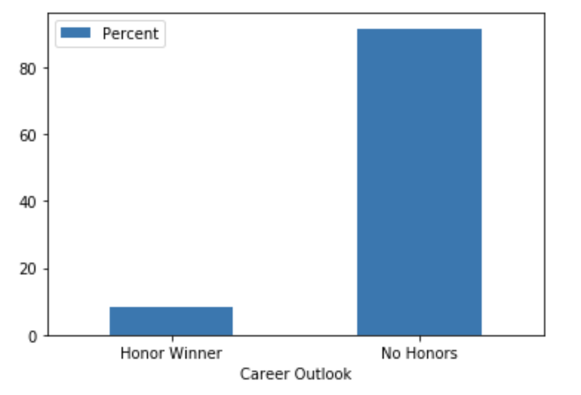
Exploratory Data Analysis
Percentage of NBA players that are “Honor Winners” (All-Star, All-NBA, All-Defense), and percentage that win “No Honors”.
Less than 10% of players win a honor; this highlights the advantage teams can gain when they can predict accurately which players will win one.

Slide 6
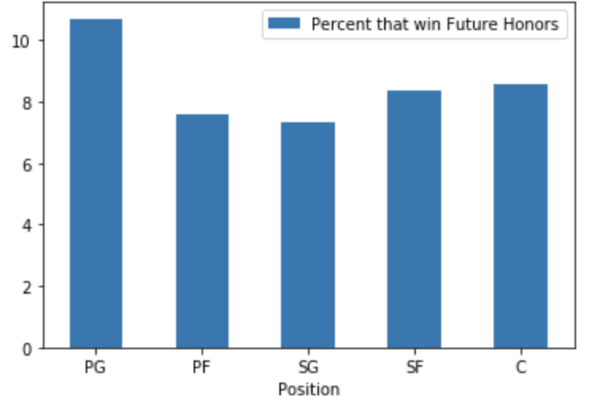
Exploratory Data Analysis
Percentage of players at each position that have won honors in their careers
Point Guards and Centers have a higher than average likelihood of achieving an honor.

Slide 7
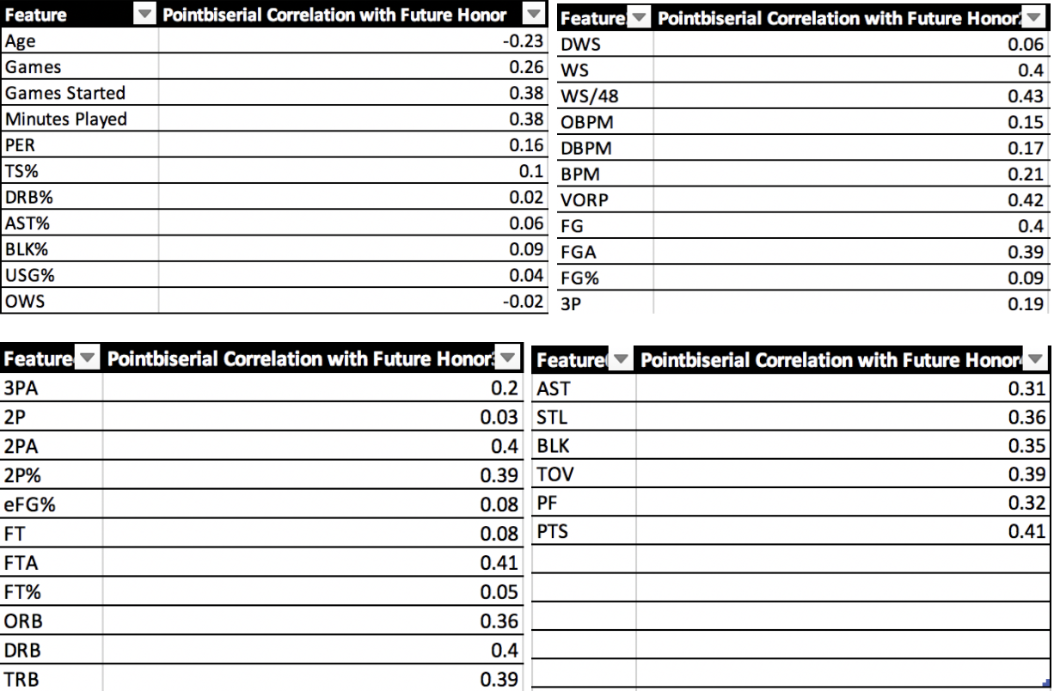
Exploratory Data Analysis
Significant (p < .05) Point Biserial Correlations between each feature and winning a “Future Honor”.
Advanced Stats (WS, WS/48, VORP) and Basic Stats (Pts, FGs) are among the highest correlations.

Slide 8
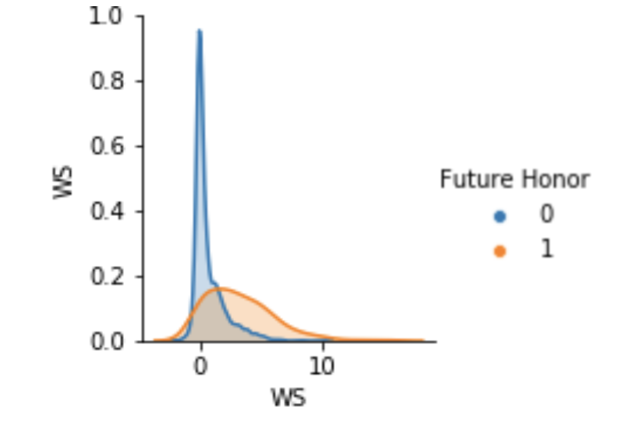
Exploratory Data Analysis
Pairplot between WS and Future Honor
Players who win honors have a WS curve wider and right-shifted compared to non-honor winners

Slide 9
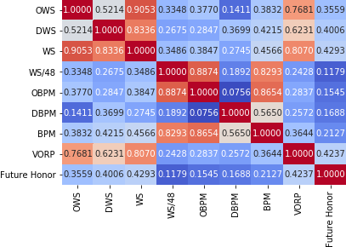
Exploratory Data Analysis
Correlation Matrices of Player Statistics to investigate Collinearity

Slide 10
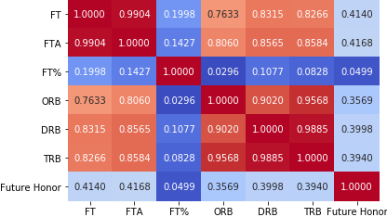
Exploratory Data Analysis
Correlation Matrices of Player Statistics to investigate Collinearity

Slide 11
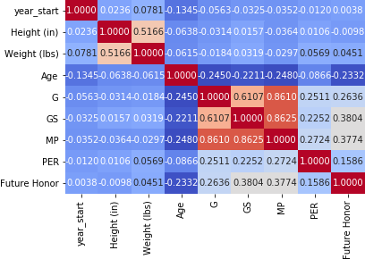
Exploratory Data Analysis
Correlation Matrices of Player Statistics to investigate Collinearity

Slide 12
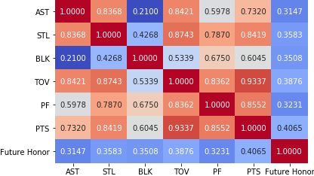
Exploratory Data Analysis
Correlation Matrices of Player Statistics to investigate Collinearity

Slide 13
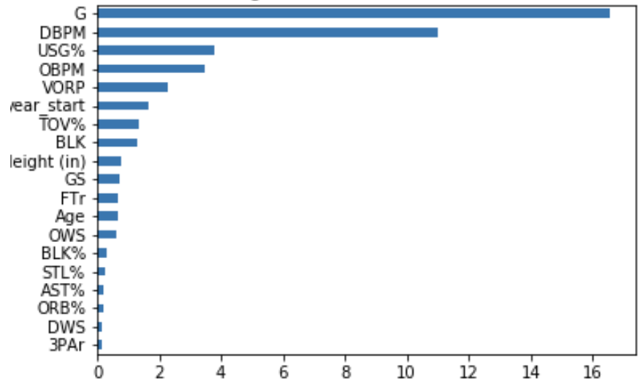
Machine Learning
Feature Importance and Selection
Isolated features with VIF scores below 10 (to avoid collinearity)
Ran logistic regression with remaining features and “Future Honor”, obtained Log-Odds for features with p<.05

Slide 14
Machine Learning
Feature Importance and Selection
Other Methods of Obtaining Feature Importances:
StatsModel Logit function to obtain coefficients for each features’ influence on winning a future honor.
Ski-Kit learn package feature importance scores for each feature

Slide 15
Machine Learning
Model Selection
Hyper-Parameter Tuning and ROC-AUC scores for Random Forest and Logistic Regression
Random Forest was used for my final model, given better ROC-AUC score.

Slide 16
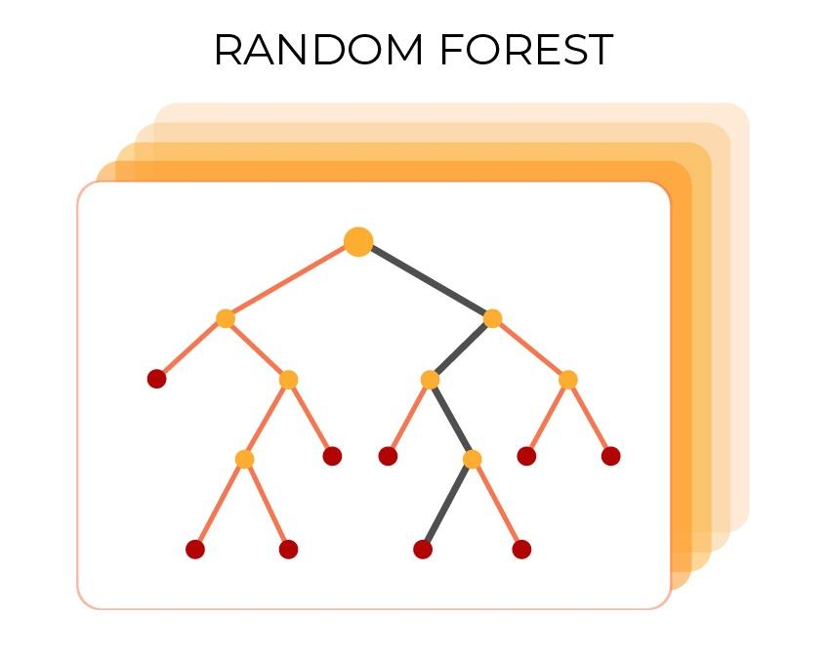
Machine Learning
Thresholding the Model
Model predicted 116 distinct probabilities for players likelihood of winning a “Future Honor”. I had to decide on a threshold probability value for which I could designate probabilities above that value as a “Future Honoree”.

Slide 17
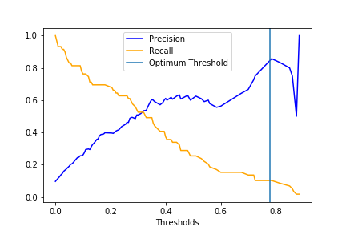
Machine Learning
Thresholding the Model: Business Case 1
NBA Head Coaches deciding on their starting five. Precision is important over recall here; the players picked should truly have Future Honoree potential or the coach is wasting valuable development time on them.

Slide 18
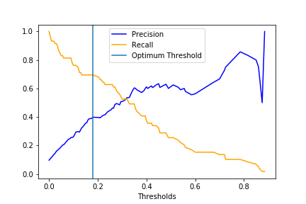
Machine Learning
Thresholding the Model: Business Case 2
NBA General Managers must decide which third and fourth year players to extend contracts to.
Recall is important here, want to keep highest proportion of future honorees as possible.

Slide 19
Conclusion
Very small % of players ascend to Future Honoree status, big advantage if they can be identified after rookie season
Advanced Statistics are as important as basic statistics for my model
Point Guards and Centers have an easier time becoming Future Honorees
Random Forest Model gave me highest accuracy levels, but the model should be used with different threshold values based on precision/recall trade-off.

Slide 20
Conclusion
Weaknesses
Model does not account for external variables impacting player success (team quality). Creating new features that account for team quality could help negate this.
Next Steps
Evaluate model’s success as current crop of young players ascend to honoree status
Incorporate players’ first 2-3 seasons into model rather than just the first season
Make individual models for All-Star, All-NBA, and All-Defense because different skill sets help for each honor.

